Slide 1
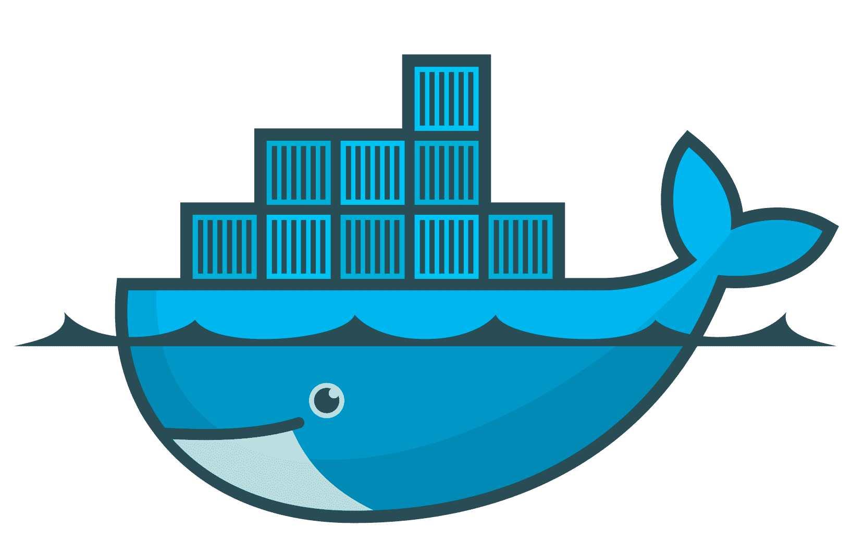
How to
yml
Run containers with Docker Composer

Slide 2
yml
Thanks for watching
Please subscribe my Youtube channel for more exciting videos

Slide 3
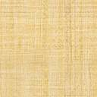

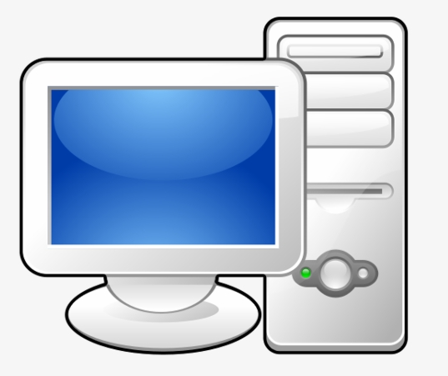
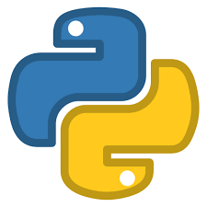

Docker Hub
Flask App

Slide 4
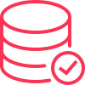
MySQL Container
Docker Network
Flask App Container

Slide 5
How to
Build Python Flask image – container

Slide 6
Thanks for watching
Please subscribe my Youtube channel for more exciting videos

Slide 7

Flask App
Docker Hub

Slide 8


Cảm ơn cả nhà đã quan tâm

Slide 9
Thanks for watching this video

